Slide 1
Introduction to ⁴⁰Ar/³⁹Ar geochronology and thermochronology
Dr Clare Warren
Helsinki,
24th October 2017

Slide 2
Learning Outcomes
You will have an understanding of:
K-Ar decay
The difference between K-Ar and ⁴⁰Ar/³⁹Ar
The age equation
How data are collected
Sources of error
You will be able to:
Manipulate the age equation
Calculate K-Ar ages
Calculate J values
Calculate ⁴⁰Ar/³⁹Ar ages
Plot ⁴⁰Ar/³⁹Ar data

Slide 3
Isotopes of natural Argon
³⁶Ar = 0.3364 ± 0.0006 %
³⁸Ar = 0.0632 ± 0.0001 %
⁴⁰Ar = 99.600 %
Atmosphere is ~1% Ar
Atmospheric ⁴⁰Ar/³⁶Ar ratio is ~298.56 ± 0.31
Lee et al., 2006

Slide 4
Isotopes of natural Potassium
³⁹K (stable; 93.2581%)
⁴⁰K (radioactive; 0.0117%)
⁴¹K (stable; 6.7302%)

Slide 5
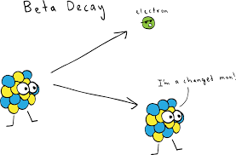
The Decay
⁴⁰K half life 1.248 x 10⁹ a
⁴⁰Ca (β decay, 89.5%)
⁴⁰Ar (electron capture, 10.5%)
Beta Decay
electron
I’m a changed man!
Image: Khan academy

Slide 6
Only ~0.011% of K consists of ⁴⁰K, and
only ~10% of ⁴⁰K decays to ⁴⁰Ar
BUT
K is a major element in numerous rock-forming minerals
So there is plenty ⁴⁰Ar to measure

Slide 7
Radiogenic ⁴⁰Ar (⁴⁰Ar*)
The amount of ⁴⁰Ar is proportional to:
The K concentration
Time (Age)
Also have ⁴⁰Ar in atmosphere
Correct using ³⁶Ar
Atmospheric ⁴⁰Ar/³⁶Ar = 298.36 ± 0.31
(Lee et al., 2006)
⁴⁰Ar* = ⁴⁰Ar_{total} - ⁴⁰Ar_{atm} - ⁴⁰Ar_{initial}

Slide 8
Radiogenic ⁴⁰Ar
The amount of ⁴⁰Ar is proportional to:
The K concentration
Time (Age)
⁴⁰Ar* = 0.1048 ⁴⁰K (e^{λt} -1)
Branching ratio as ⁴⁰K decays to ⁴⁰Ca (89.5%)
and ⁴⁰Ar (10.5%)
* = radiogenic
t = time
λ=5.543 x 10⁻¹⁰ a⁻¹

Slide 9
So let’s rearrange for t
⁴⁰Ar* = 0.1048 ⁴⁰K (e^{λt} -1)

Slide 10
Let’s rearrange for t
⁴⁰Ar* = 0.1048 ⁴⁰K (e^{λt} -1)
t = ln [ (⁴⁰Ar/0.1048 ⁴⁰K) +1 ]
λ
the unknowns are ⁴⁰K and ⁴⁰Ar
What is 1/λ in Ma?
λ=5.543 x 10⁻¹⁰ a⁻¹

Slide 11
Let’s rearrange for t
⁴⁰Ar* = 0.1048 ⁴⁰K (e^{λt} -1)
t = ln [ (⁴⁰Ar/0.1048 ⁴⁰K) +1 ]
λ
the unknowns are ⁴⁰K and ⁴⁰Ar
What is 1/λ in Ma?
1804.077

Slide 12
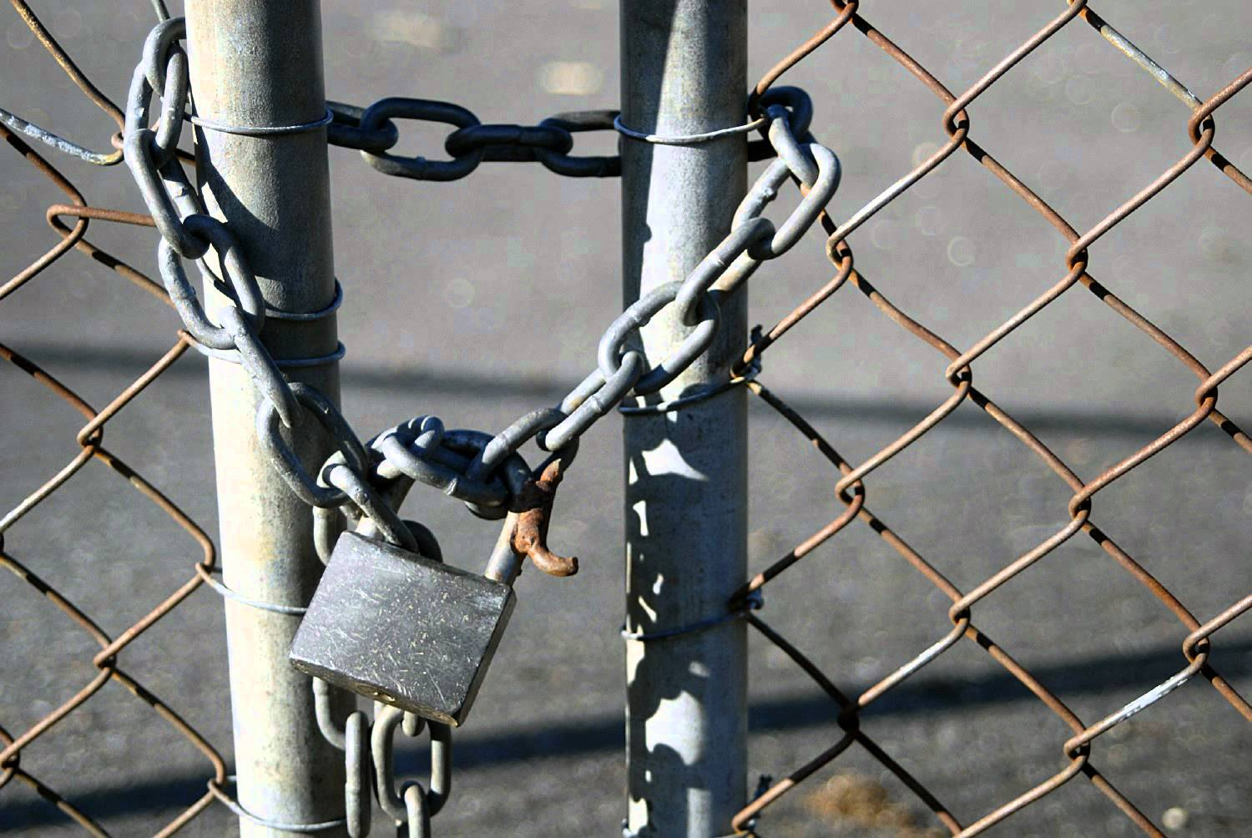
Requirements for a K-Ar age
Constant decay constants
Sample ⁴⁰Ar is either all radiogenic OR non-radiogenic ⁴⁰Ar can be corrected
Closed system
Image: YouTube.com

Slide 13
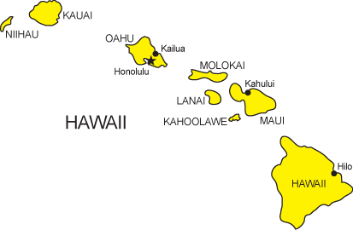
So let’s calculate!
McDougall 1964
t = 1804.077 ln [ (⁴⁰Ar/0.1048 ⁴⁰K) +1 ]
Image: state-maps.org

Slide 14
What is the age range for each island?
Island | ⁴⁰Ar/⁴⁰K max | ⁴⁰Ar/⁴⁰K min | Age in Ma?
Kauai | 3.34 x 10⁻⁴ | 2.22 x 10⁻⁴
W Oahu | 2.14 x 10⁻⁴ | 1.60 x 10⁻⁴
East Oahu | 1.50 x 10⁻⁴ | 1.30 x 10⁻⁴
W Molokai | 1.08 x 10⁻⁴ | --
E Molokai | 8.81 x 10⁻⁵ | 7.74 x 10⁻⁵
W Maui | 7.68 x 10⁻⁵ | 6.77 x 10⁻⁵
E Maui | 4.86 x 10⁻⁵ | --
t = 1804.077 ln [ (⁴⁰Ar/0.1048 ⁴⁰K) +1 ]

Slide 15
What have you found?
Image: state-maps.org

Slide 16
What have you found?
5.74-3.82 Ma
2.58-2.24Ma
3.68-2.75 Ma
1.52-1.33 Ma
1.86 Ma
1.32-1.17Ma
0.8 Ma
Implications?
Present-day
eruptions
Image: state-maps.org
McDougall 1964

Slide 17
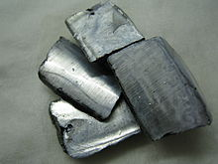
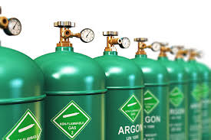
K-Ar vs Ar/Ar
Image: Wikipedia
Image: istockphoto.com

Slide 18
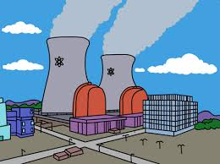
Irradiation
³⁹K→³⁹Ar
by neutron bombardment
93.26% of all K is ³⁹K
We can then just measure ⁴⁰Ar and ³⁹Ar instead of ⁴⁰Ar and ⁴⁰K
Image from The Simpsons

Slide 19
Relationship between ³⁹Ar → ⁴⁰K?
Every ³⁹Ar forms from a ³⁹K
³⁹K (stable; 93.2581%)
⁴⁰K (radioactive; 0.0117%)
For every ³⁹K atoms how many ⁴⁰K?

Slide 20
Relationship between ³⁹Ar → ⁴⁰K?
Every ³⁹Ar forms from a ³⁹K
³⁹K (stable; 93.2581%)
⁴⁰K (radioactive; 0.0117%)
For every ³⁹K atoms, how many ⁴⁰K?
0.0001255

Slide 21
Other irradiation products
Image from: http://studylib.net/doc/18050406/ar-ar-geo--thermochronology

Slide 22
⁴⁰K → ³⁹Ar ?
t = ln [ (⁴⁰Ar/0.1048 ⁴⁰K) +1 ]
λ
t = ln [ J (⁴⁰Ar*/³⁹Ar) +1 ]
λ
J includes: abundances of K isotopes
branching ratio
irradiation dose

Slide 23
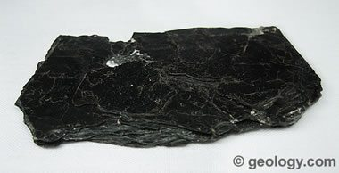
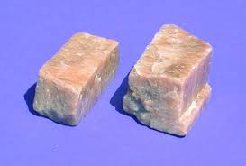
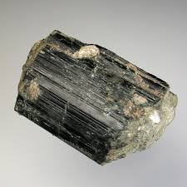
Standard of known age
Biotite: GA 1550; ~79 Ma
Fish Canyon Sanidine, ~28 Ma
Hornblende Hb3gr; ~1074 Ma
These are irradiated with the samples of unknown age
Image: e-rocks.com
Image: Pitt.edu

Slide 24
Irradiation factor (J values)
(t/1804.077)
J = e
-1
R
Where R (ratio) = ⁴⁰Ar_{(atm} _{corr)}
³⁹Ar
And t = age of standard (Ma)

Slide 25
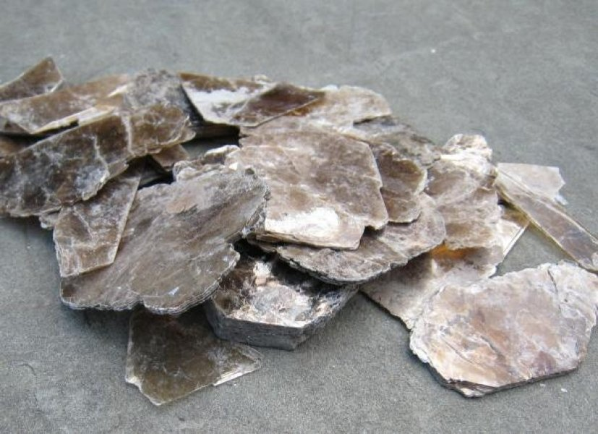
How do we date a rock or mineral?
Pick rock fragments or minerals
Load with standards
Irradiate
Load into mass spec
Heat/melt/ablate
Measure ³⁶Ar, ³⁷Ar, ³⁸Ar, ³⁹Ar, ⁴⁰Ar
Calculate J value for each sample
Calculate sample age
Image: ScienceDaily.com

Slide 26
Collecting data
Step Heating
Single Grain Fusion
Laser Ablation
Crushing
Image: Open.ac.uk

Slide 27
Basically
Thermal or mechanical release of Ar from sample
Cleaning gas to remove interferences
Measurement
Image: Open.ac.uk

Slide 28
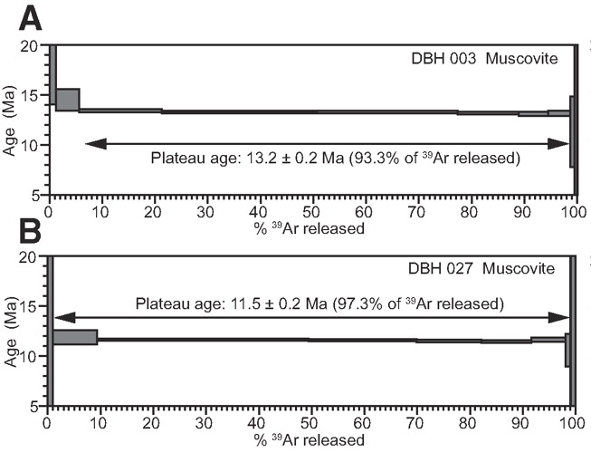
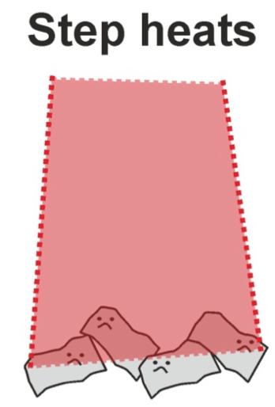
Dating – step heating
Multi-grain;
Single grain
Images: Catherine Mottram; Kellett et al., 2009

Slide 29
Plotting data: Step Heating
Age calculate for each temperature step
Plateau: Fleck et al (1977): 3 or more contiguous steps; > 50% released ³⁹Ar_{K} + overlapping at 2σ
Fit calculated by MSWD
Image: Kellett et al., 2009

Slide 30
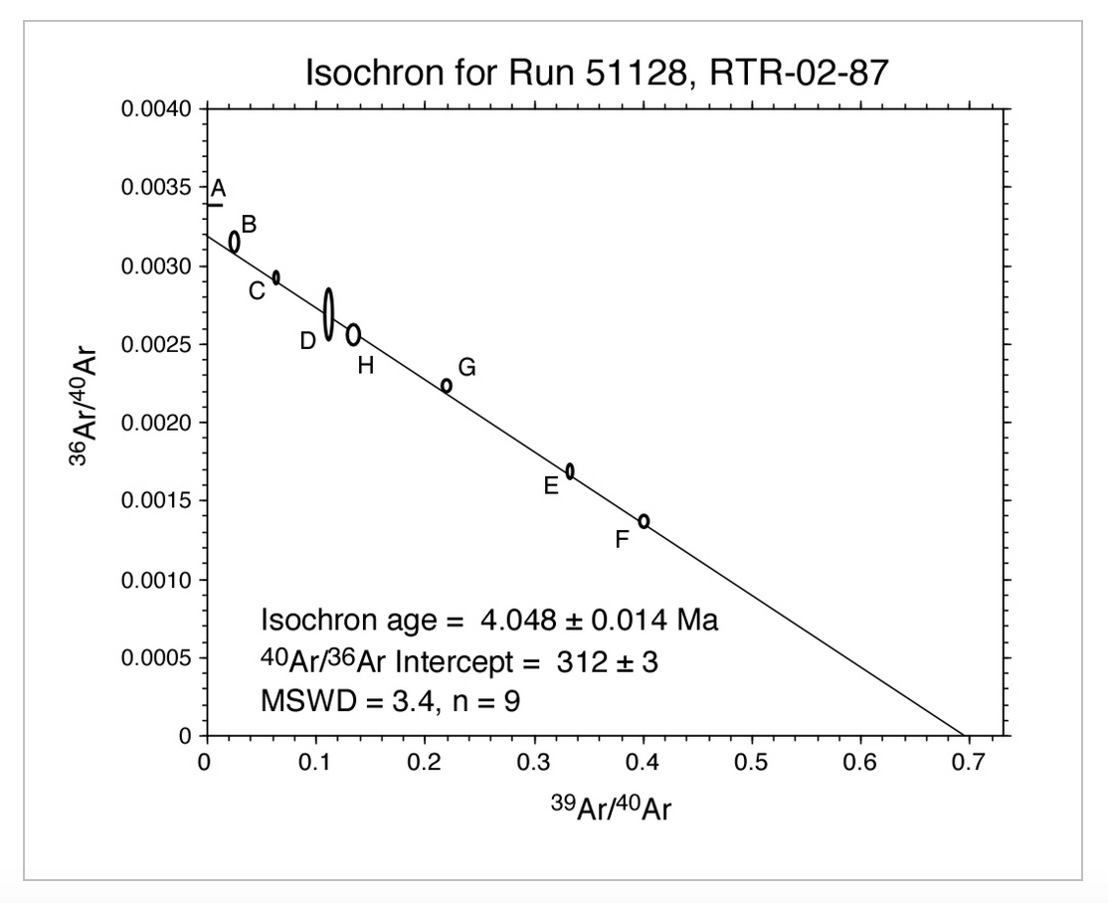
Plotting data: Inverse Isochrons
Assess Ar isotopic composition at each T step
Trapped ³⁶Ar/⁴⁰Ar value at y intercept
³⁹Ar/⁴⁰Ar on x intercept
Image: https://geoinfo.nmt.edu/labs/argon/data/home.html

Slide 31
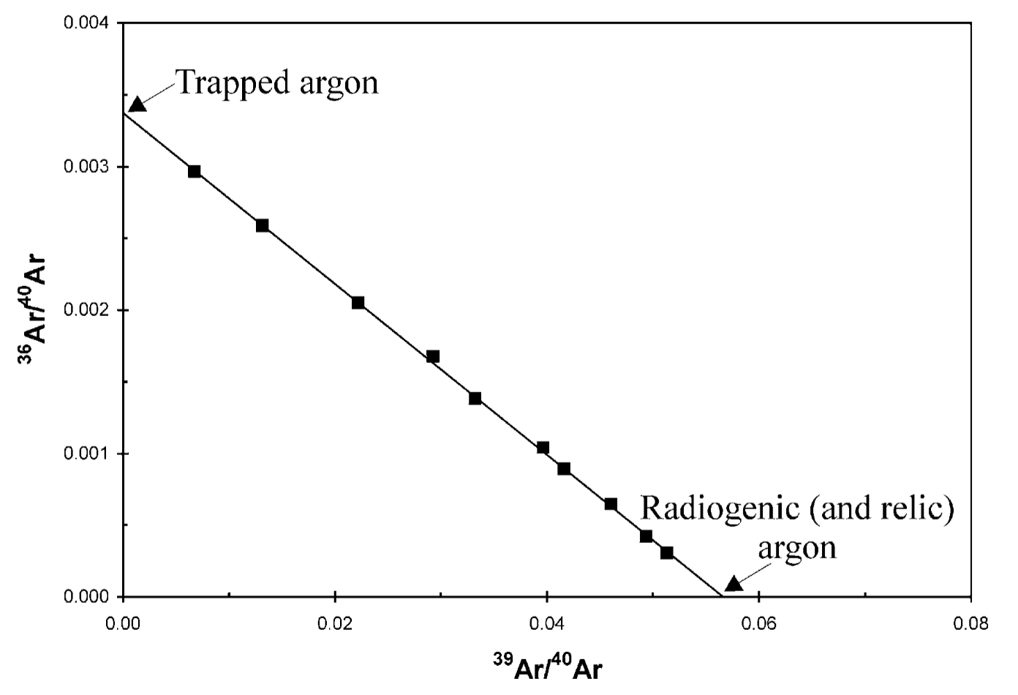
Kuiper, 2002

Slide 32
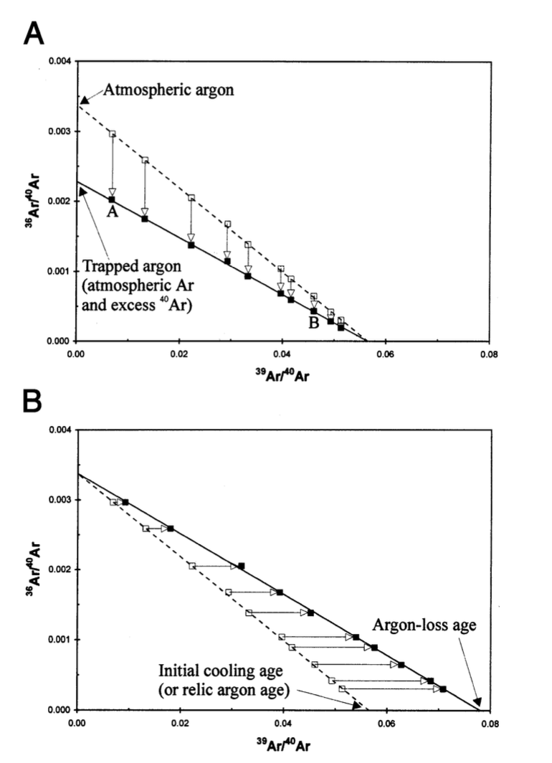
Kuiper, 2002

Slide 33
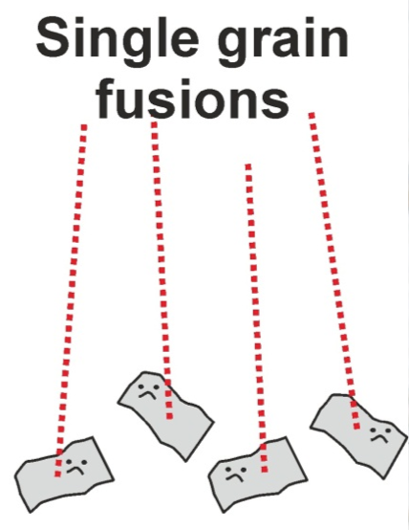
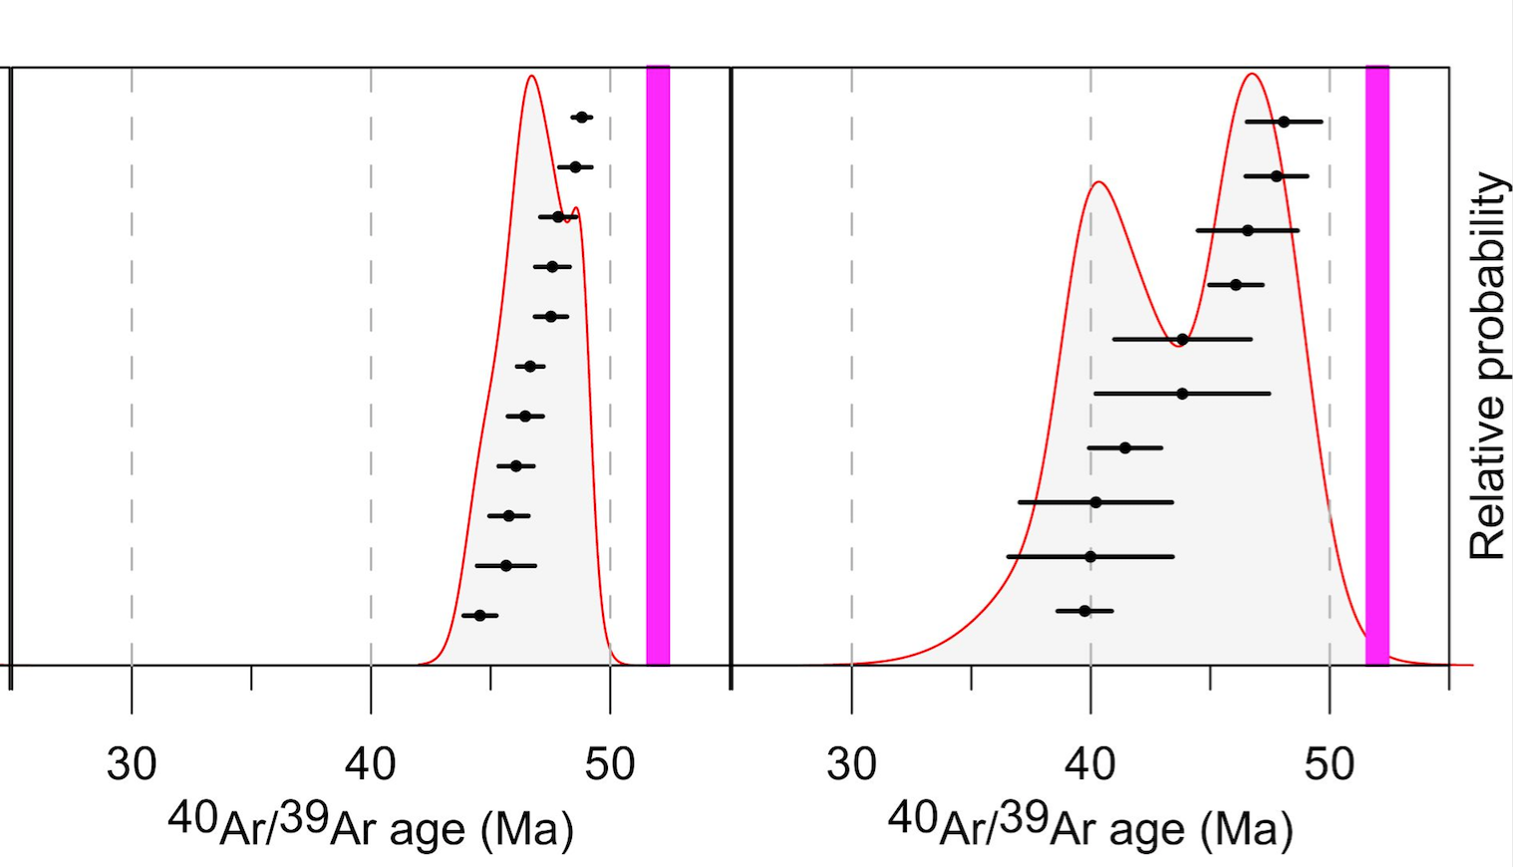
Dating – single grain fusion
Single grain
Images: Catherine Mottram; Bertram Uunk

Slide 34
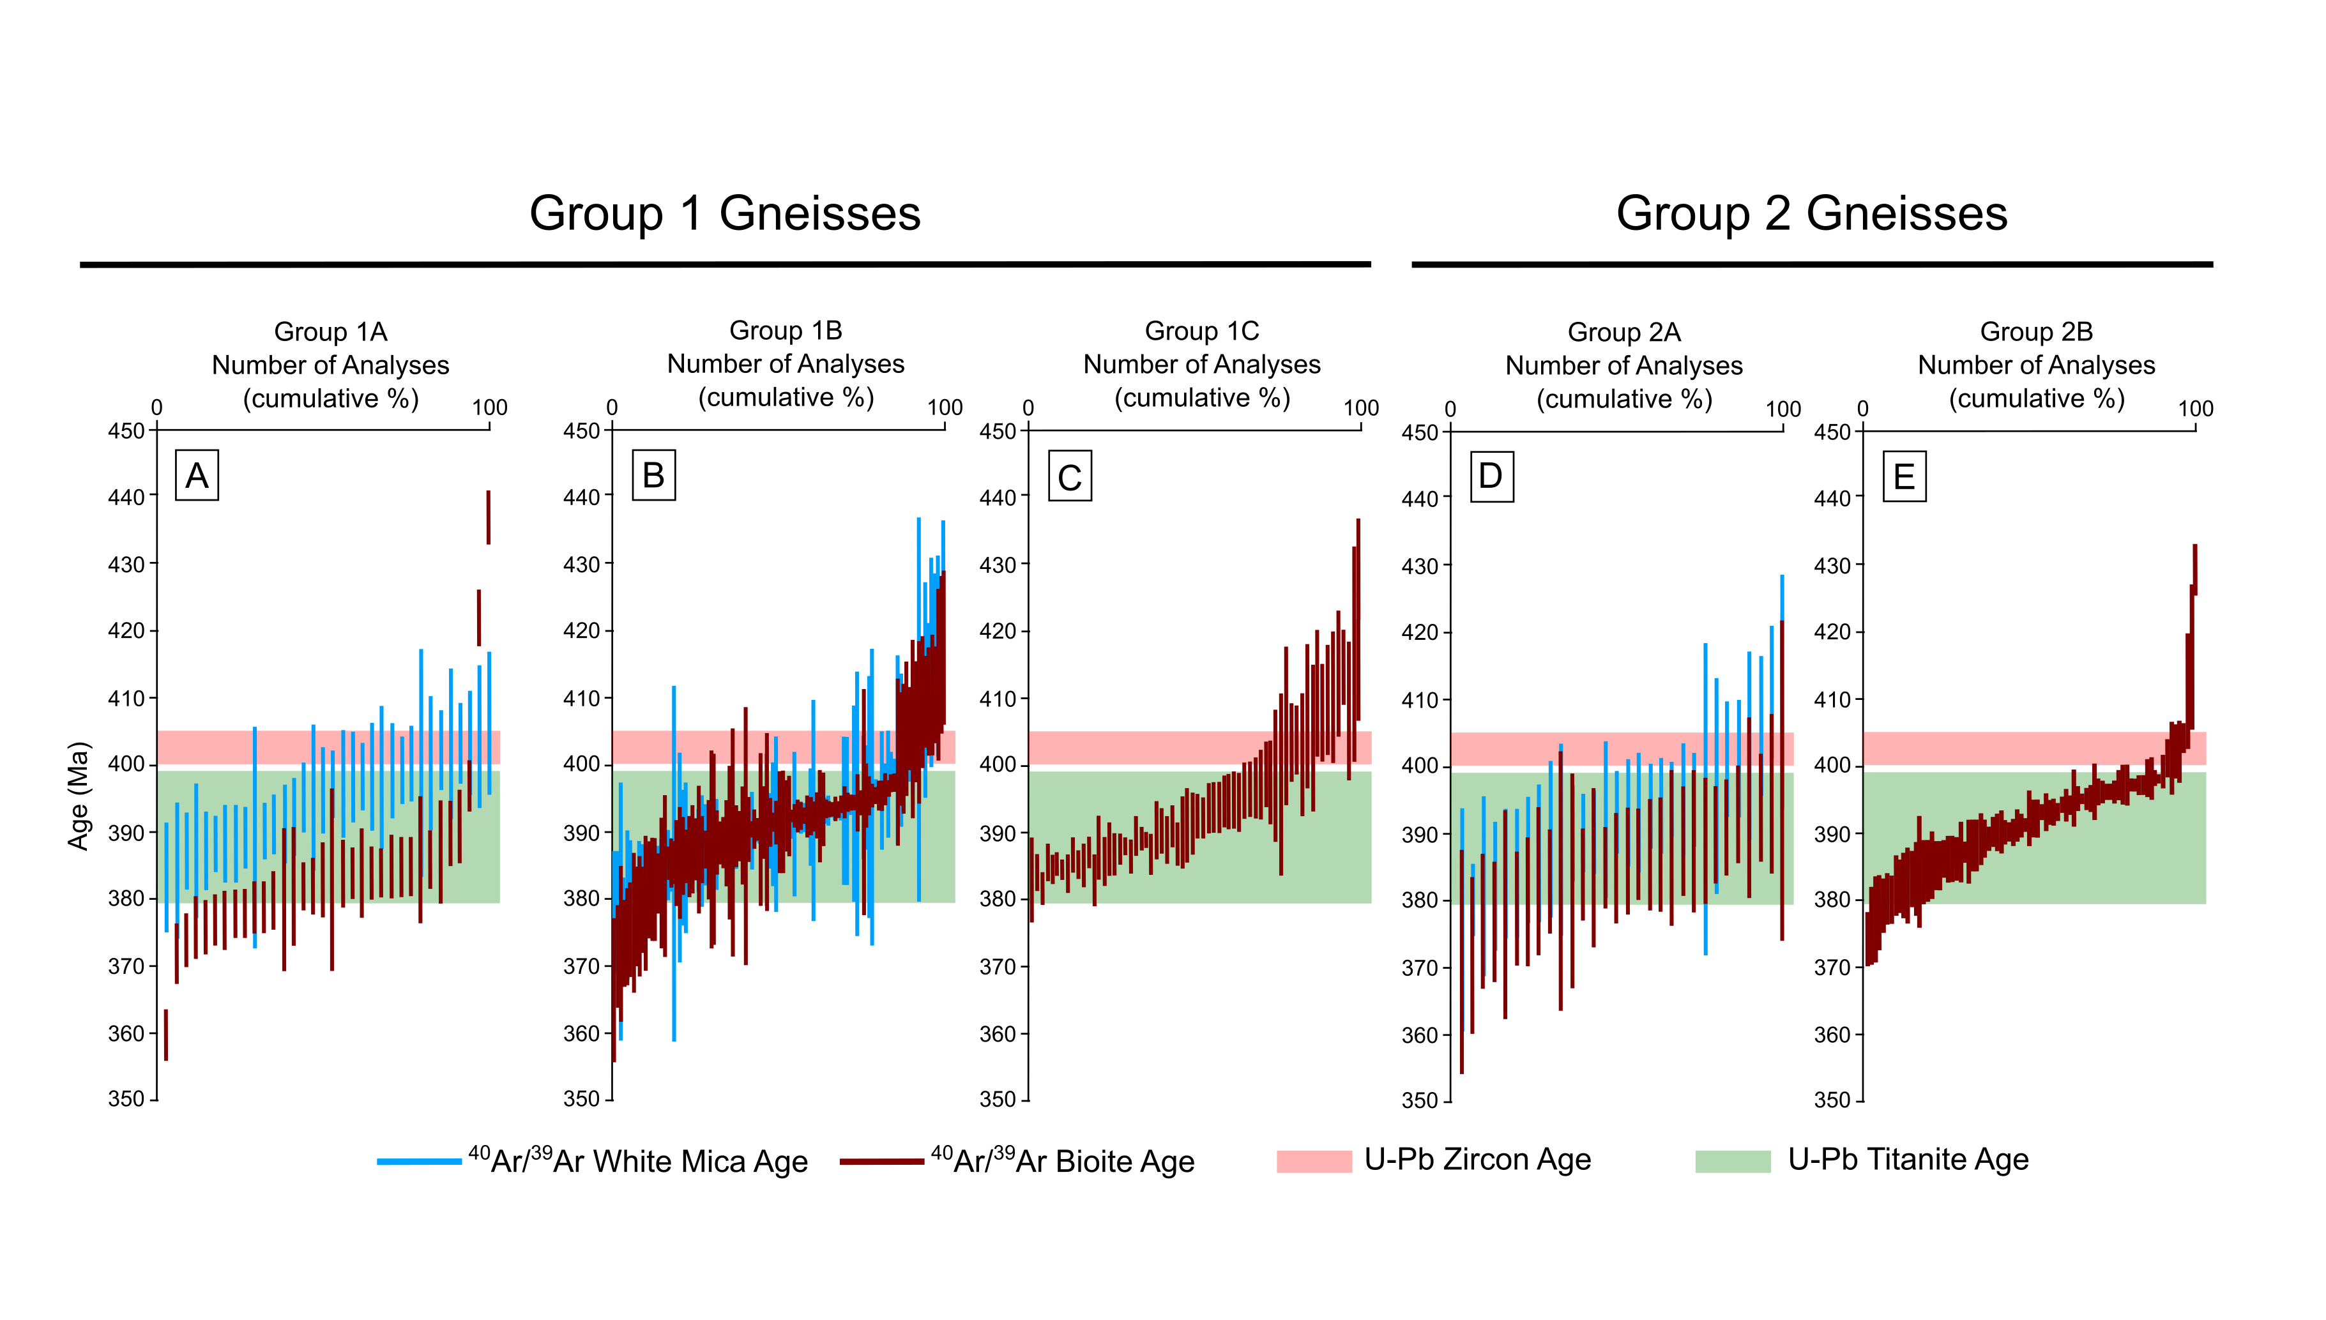
Plotting data: single grain fusions
Image: McDonald et al., 2016

Slide 35
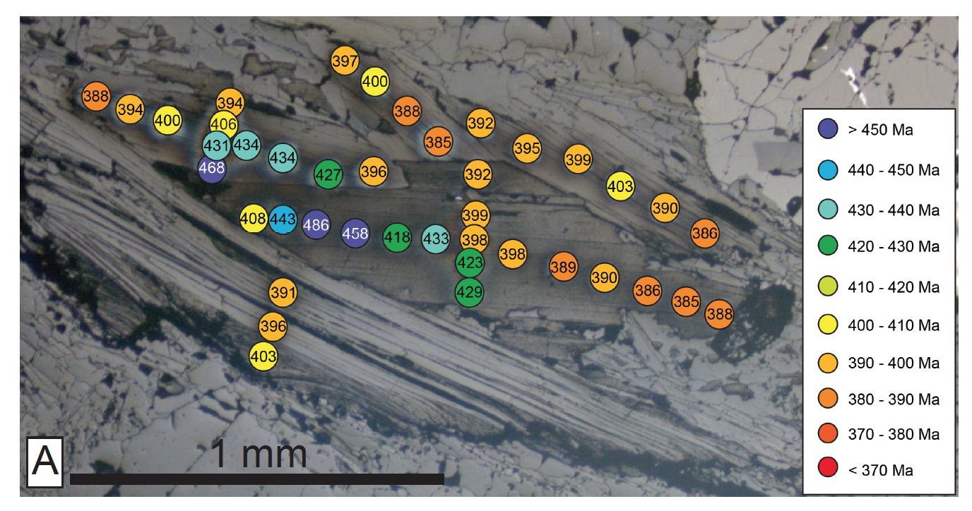
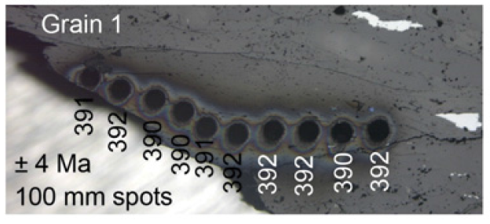
Dating – laser ablation
Laser probe
15 μm diameter spots
Single spot
Image: Chris McDonald; McDonald et al., 2016

Slide 36
Minerals commonly dated with ⁴⁰Ar/³⁹Ar
Formula | Mineral
KAl₃Si₃O₁₀(OH)₂
K(Mg,Fe)₃AlSi₃O₁₀(F,OH)₂
(K,Na)₀₋₁(Ca,Na,Fe,Mg)₂(Mg,Fe,Al)₅(Al,Si)₈O₂₂(OH)₂
KAlSi₃O₈
(K,Na)AlSi₃O₈- CaAl₂Si₂O₈
(K,H₃O)(Al,Mg,Fe)₂(Si,Al)₄O₁₀[(OH)₂,(H₂O)]

Slide 37
Minerals commonly dated with ⁴⁰Ar/³⁹Ar
Formula | Mineral
KAl₃Si₃O₁₀(OH)₂ | Muscovite
K(Mg,Fe)₃AlSi₃O₁₀(F,OH)₂ | Biotite
(K,Na)₀₋₁(Ca,Na,Fe,Mg)₂(Mg,Fe,Al)₅(Al,Si)₈O₂₂(OH)₂ | Hornblende
KAlSi₃O₈ | K-feldspar
(K,Na)AlSi₃O₈- CaAl₂Si₂O₈ | Plagioclase
(K,H₃O)(Al,Mg,Fe)₂(Si,Al)₄O₁₀[(OH)₂,(H₂O)] | Illite

Slide 38
Minerals commonly dated with ⁴⁰Ar/³⁹Ar
Basalt
Tuff
Rhyolite
Meteorites
Can date whole rocks as young as 1000 yrs (but difficult!)

Slide 39
“Types” of Argon
Atmospheric argon (Ar_{atm)}: ⁴⁰Ar/³⁶Ar = 298.56
Radiogenic ⁴⁰Ar (⁴⁰Ar*): from natural ⁴⁰K decay
Inherited/excess Ar (mixture of Ar_{atm} and ⁴⁰Ar*)
Irradiation-induced argon (from neutron bombardment of K, Ca, Cl

Slide 40
Calculating the ⁴⁰Ar/³⁹Ar ratio
⁴⁰Ar needs correcting for instrument background (blank)
And for atmospheric ^{40Ar}:
⁴⁰Ar* = ⁴⁰Ar_{meas} – (298.56 x ³⁶Ar)
³⁹Ar needs correcting for ³⁹Ar produced in the reactor from Ca (minor correction, ignored here)

Slide 41
Time to calculate some J values
(λt)
J = exp
-1
R
R = ⁴⁰Ar*/³⁹Ar
Standard | t (Ma) | Ref | R | J?
GA 1550 | 99.738 | Renne et al 2011 | 0.9361
GA 1550 | 99.738 | Renne et al 2011 | 0.6752
FCT | 29.305 | Renne et al 2010 | 1.112

Slide 42
Time to calculate some J values
(λt)
J = exp
-1
R
R = ⁴⁰Ar*/³⁹Ar
Standard | t (Ma) | Ref | R | J?
GA 1550 | 97.938 | Renne et al 2011 | 0.9361 | 0.06072
GA 1550 | 97.938 | Renne et al 2011 | 0.6752 | 0.08418
FCT | 29.305 | Renne et al 2010 | 1.112 | 0.01472

Slide 43
Let’s calculate some ages
Correct ⁴⁰Ar, ³⁹Ar and ³⁶Ar for background
Correct ⁴⁰Ar for atmosphere (278.56)
Calculate ⁴⁰Ar*/³⁹Ar
Calculate age
t (Ma) = 1804.077 ln (1 + JR)
Where J = J value
R = ⁴⁰Ar*/³⁹Ar

Slide 44
Grain | ⁴⁰Ar | ³⁹Ar | ³⁶Ar
1 | 2.80241 | 0.10112 | 0.000069
2 | 1.64699 | 0.05999 | 0.000029
3 | 4.63017 | 0.17070 | 0.000009
4 | 1.16425 | 0.04235 | 0.000049
5 | 2.54924 | 0.09347 | 0.000019
6 | 1.29521 | 0.04536 | 0.000039
7 | 2.31139 | 0.08456 | 0.000049
8 | 5.03872 | 0.18459 | 0.000059
9 | 2.32016 | 0.08485 | 0.000059
10 | 7.54618 | 0.28182 | 0.000039
Blank | 0.002958 | 0.000015 | 0.000012
J = 0.008733

Slide 45
Grain | Age (Ma)
1 | 388.6
2 | 386.1
3 | 383.3
4 | 384.1
5 | 384.8
6 | 398.7
7 | 384.2
8 | 384.6
9 | 383.8
10 | 378.6

Slide 46
Plot the results…
As a plot of increasing age (y) vs sample (add error bars; errors given in spreadsheet)
As an inverse isochron plot (36/40 on y vs 39/40 on x), with the max on y being the 36/40 air ratio.

Slide 47
Generally a coherent population with 2 outliers
Most Ar is radiogenic – little atmospheric contamination

Slide 48
Discussion: sources of error

Slide 49
Discussion: sources of error
Age of standard
Decay constants
Irradiation product corrections
J value
Measurement uncertainties (blanks and measurements)

Slide 50
Learning Outcomes
You will have an understanding of:
K-Ar decay
The difference between K-Ar and ⁴⁰Ar/³⁹Ar
The age equation
How data are collected
Sources of error
You will be able to:
Manipulate the age equation
Calculate K-Ar ages
Calculate J values
Calculate ⁴⁰Ar/³⁹Ar ages
Plot ⁴⁰Ar/³⁹Ar data

Slide 51
Extra references
http://studylib.net/doc/18050406/ar-ar-geo--thermochronology

